Slide 1
Mammary gland
Dr. Ashraff Waleed Abdulrazaq

Slide 2
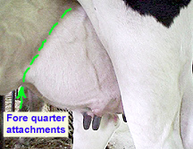
Anatomy

Slide 3
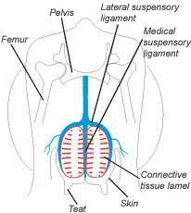

Slide 4
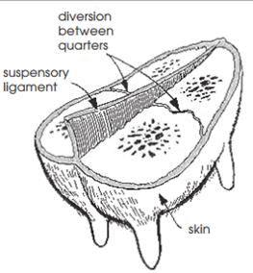

Slide 5
